Slide 1

Pack Meeting Pack 232
November 19th 2019

Slide 2
Pack Meeting – Nov. 19th
Gathering – Make Silly Putty!!!
Opening – Pledge/Oath/Law/Outdoor Code
Program – Bethlehem History
Game – Face the Cookie!!!!
Recognition - Awards
Snacks
Announcements
Cubmaster’s Minute

Slide 3
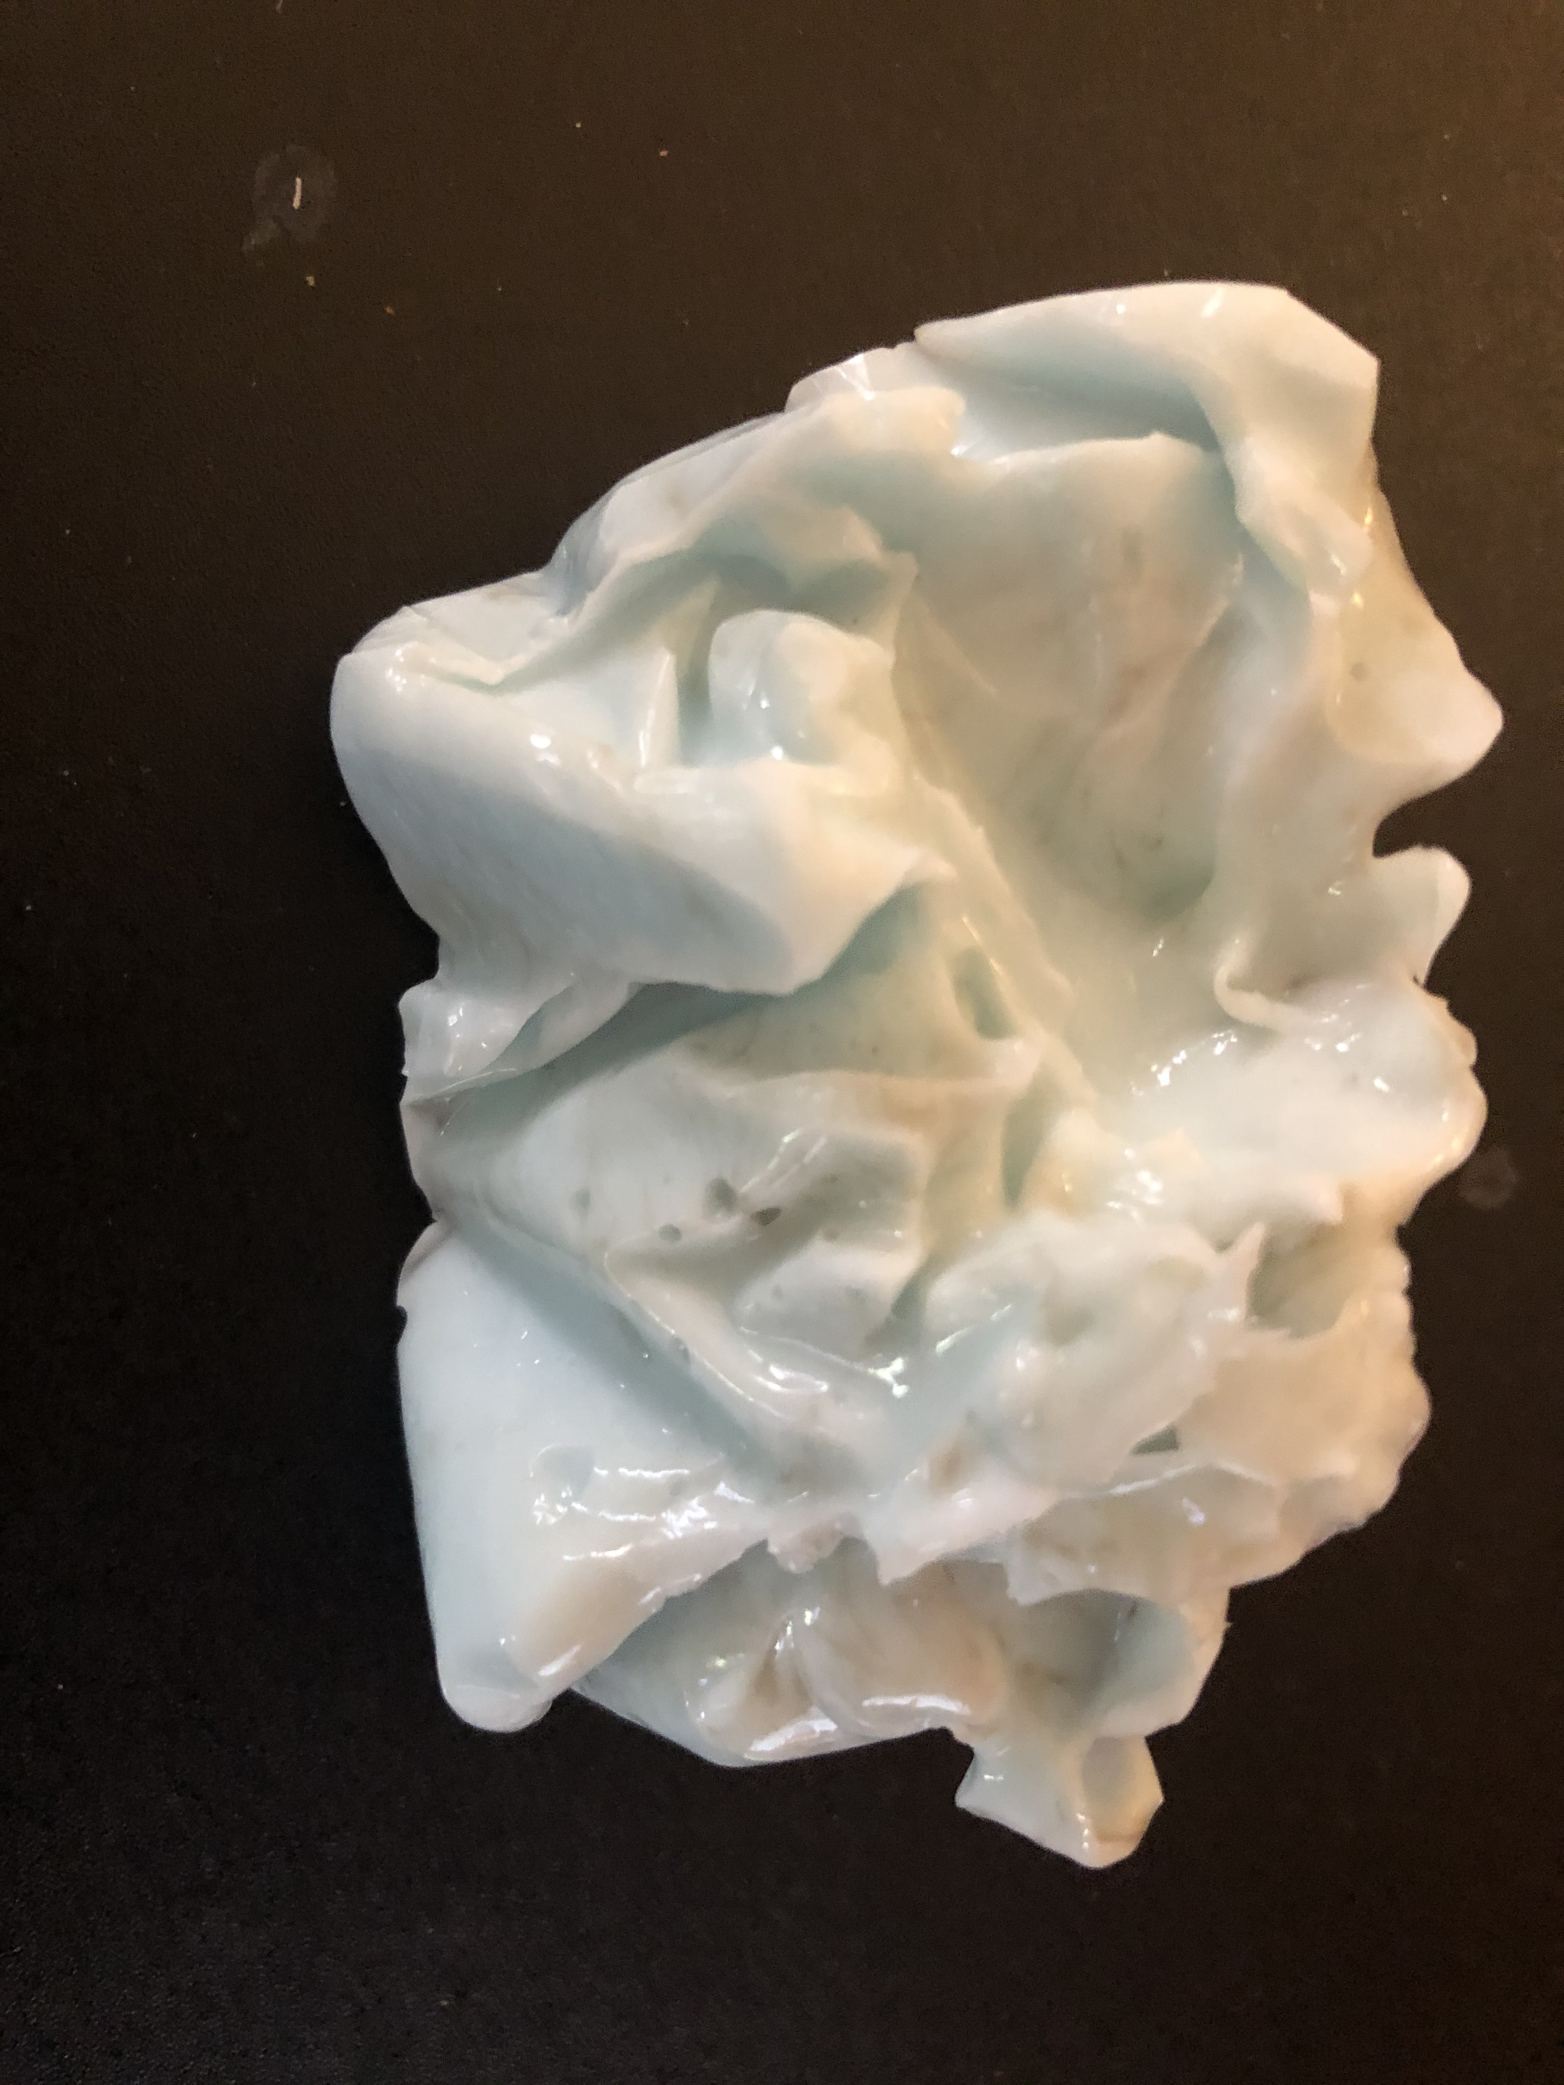
Making Silly Putty
Get a bowl, spoon, and SOLO red cup
Using the ½ cup measuring cup, pour 3/8th cup (have an adult guestimate) of the Colored Borax Solution in your bowl
Using the 1 cup measuring cup, pour ¾ cup of the Glue Solution into your red cup and then pour SLOWLY from the red cup into your bowl while stirring with the spoon
When the liquids are fully combined in the bowl, form the solids into a ball with your hands (it will feel like snot!!)
Put silly putty ball in plastic bag to take home
WASH YOUR HANDS WHEN ALL DONE!!!!

Slide 4
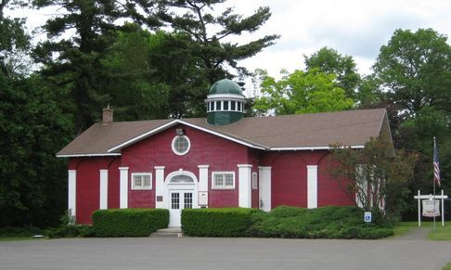
Bethlehem History

Slide 5

GAME

Slide 6
Awards and Den Reports

Slide 7

Scouting for Food Coordinator
Blue & Gold Picnic Coordinator
Pinewood Derby Team
Pack 232 t-shirt Coordinator
Membership Coordinator (social media expertise is a plus)

Slide 8
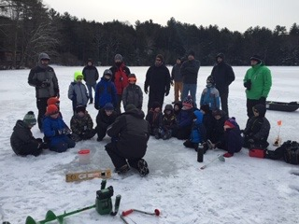
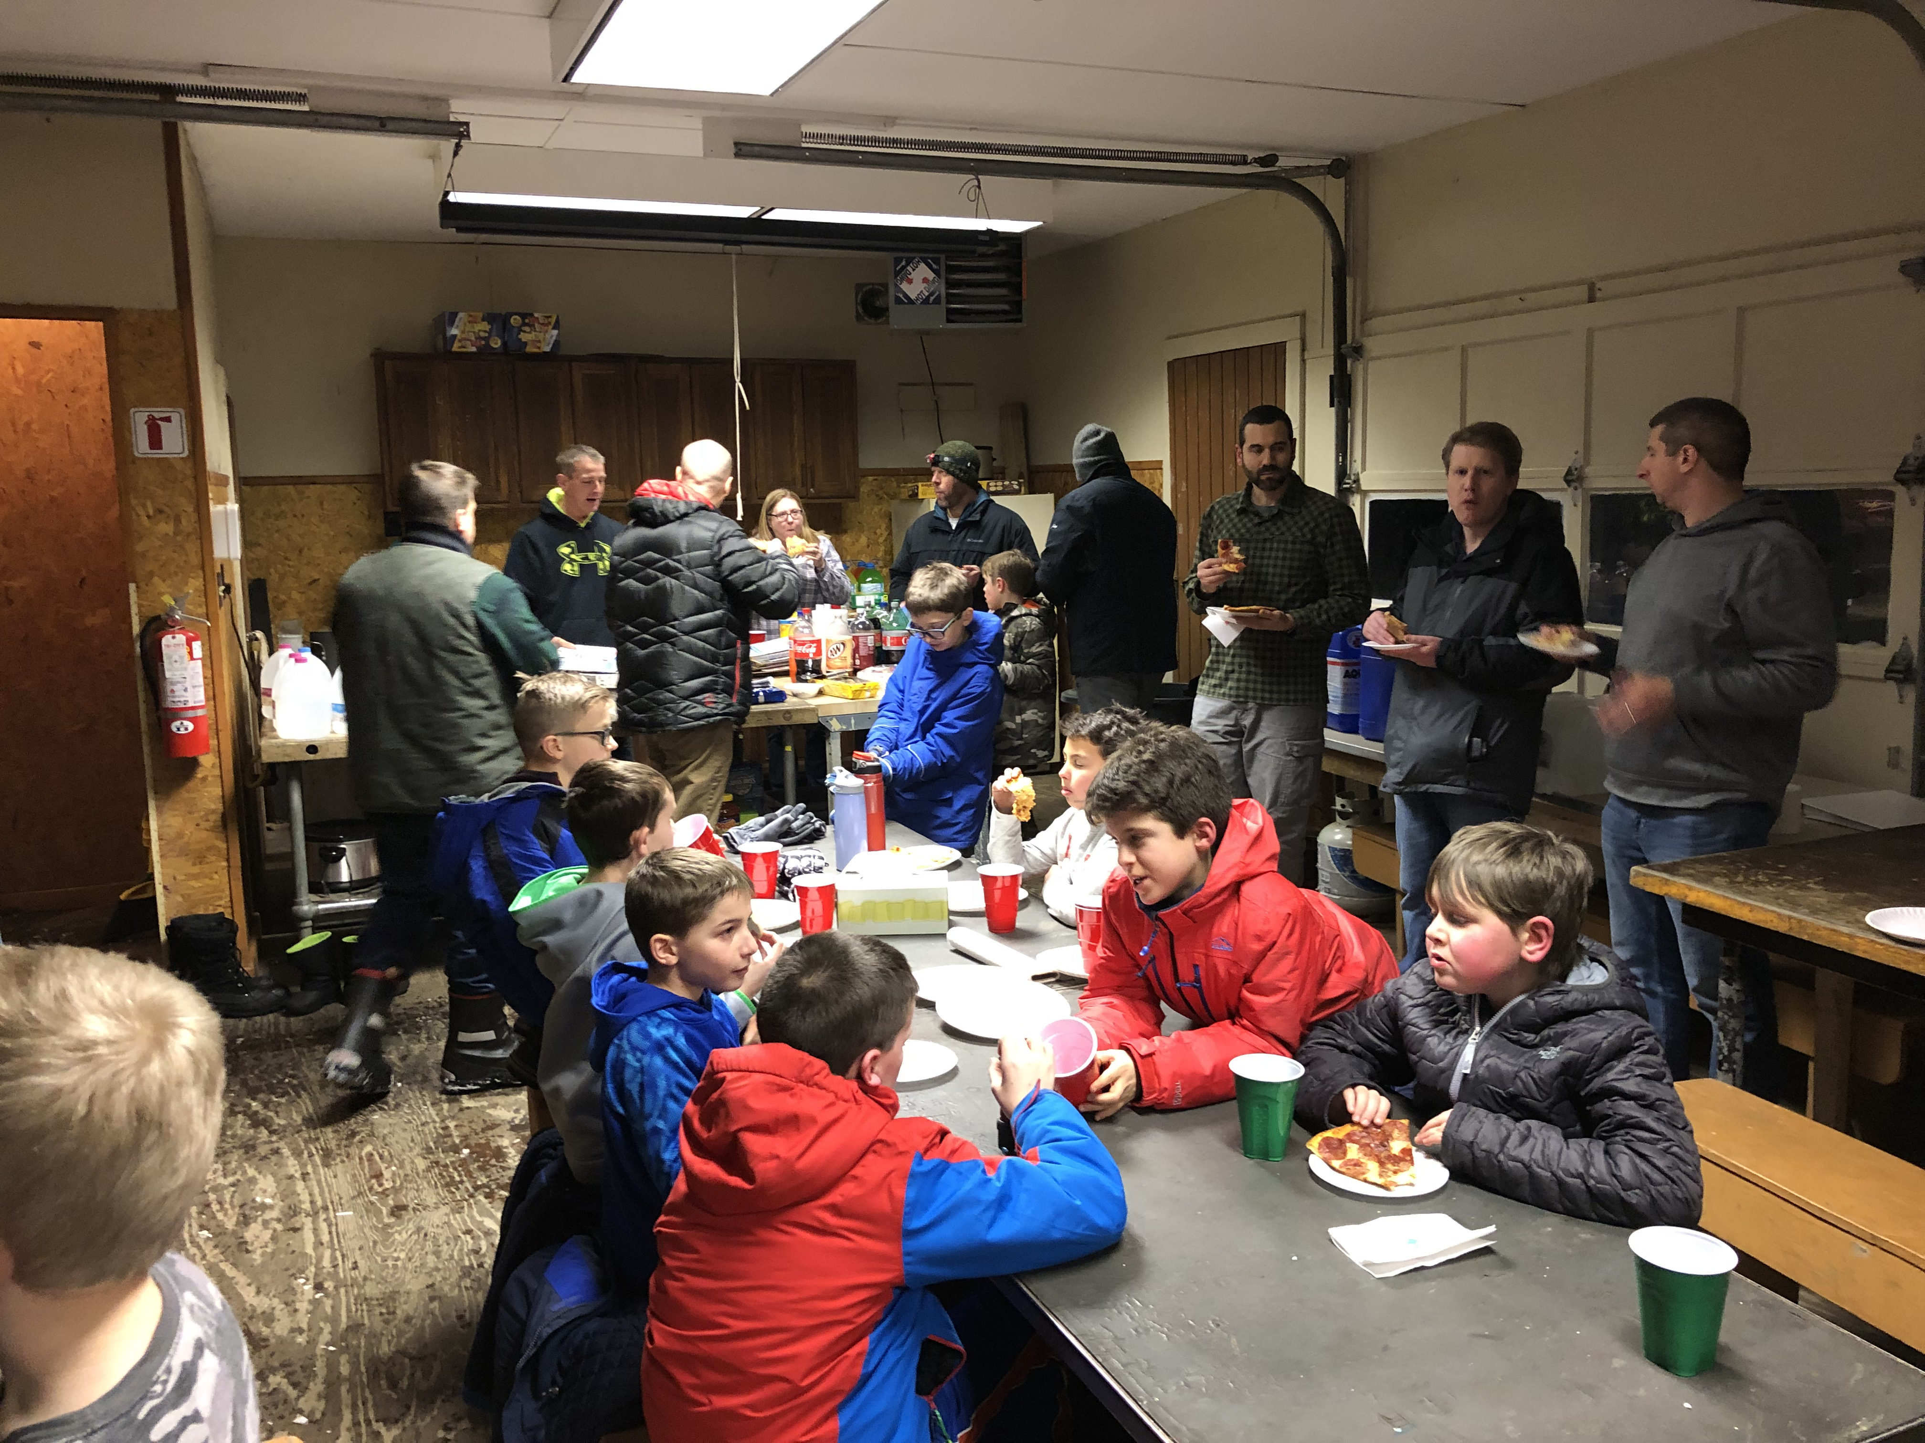
SAVE THE DATE!!!!!
Winter HEATED CABIN Camping is 2/07 - 2/09/2020 (you will be home well before the Super Bowl starts):
At Rotary Scout Reservation (279 Davitt Lake Road, Poestenkill)
Hiking, Sledding, Games, Movies, Ice Fishing, Astronomy
Cost per person is TBD (Meals and DESSERTS! provided)
Capacity = 78 (1 adult per family, no non-scout siblings)
Registration to Go Live on Sunday, December 1 at 9am
In 2019, registration closed out in 9 hours!!!!!!!!!!!

Slide 9
SAVE THE DATE!!!
STEM Day Camp
For Wolves (2nd Grade) - Arrow of Lights (5th Grade).
Teaching problem solving, programming, team building, and much more!
Build your own computer! and take it home!
When = February 18 – 21
Where = Shaker High School (445 Watervliet Shaker Road, Latham)
Cost = $225

Slide 10
Other Pack Events
Caroling for RMH = 12/17 @ 6pm
Indoor Rock Climbing = January
Bethlehem Cub Scout Winter Carnival = Jan/Feb
Tubing = February
Pack Pinewood Derby = 3/07
Howe Caverns = 3/28
Visit a Blacksmith Forge = April
Cub Scout Day at Rotary = 5/02
USS Slater Sleepover = 5/08 – 5/09
Spring Hike = 5/17
Summer Resident Camp at Rotary = 8/02 – 8/06

Slide 11
Next Pack Meeting Tuesday, December 10 (6:30PM-8PM)
Bears (3rd Grade) Den is the Host
Gathering – Craft stick noisemakers
Program – Knots!!!
Games –
Cub Scout Foosball
Hula Hoop Rock Paper Scissors
Awards
Snacks

Slide 12
Cubmaster’s Minute
Thanksgiving is almost here and that means: a school holiday, the Turkey Trot, football games to play in and/or watch, starting your holiday gift wish list, but most importantly a time with your family to have a big Turkey dinner with all of the trimmings.
Before Thanksgiving passes, I want you to take a few minutes to think about what it really means. Thanksgiving started out to be a time for giving thanks for the blessings that the Pilgrims and the Native Americans had. Please keep that in your thoughts when you celebrate Thanksgiving.
Remember in the Scout Oath that a Scout is Reverent. So when you sit down with your family to your big Thanksgiving dinner, don’t forget to offer your thanks, not only for the food you are about to eat but for all of the other blessings in your life.
Have a wonderful Thanksgiving!

